Slide 1
Strategy Patterns
Strategy Pattern Basics and Implementation

Slide 2
Origin
First defined in the 1994 book Design Patterns: Elements of Reusable Object-Oriented Software
Strategy pattern encapsulates alternative algorithms (or strategies) for a particular task.

Slide 3
Overview
The strategy pattern (also known as the policy pattern) is a behavioral software design pattern that enables selecting an algorithm at run-time.
Instead of implementing a single algorithm directly, code receives run-time instructions as to which in a family of algorithms to use.
Strategy lets the algorithm vary independently from clients that use it.

Slide 4
Wait...what?
Basically strategy pattern helps us separate the parts of an object which are subject to change from the rest of the static bits.

Slide 5
But Why?
Deferring the decision about which algorithm to use until run-time allows the calling code to be more flexible and reusable.
Used to manage algorithms, relationships and responsibilities between objects.
Using Strategy objects versus subclasses can often result in much more flexible code since we're creating a suite of easily swappable algorithms.

Slide 6
In other words...
The Strategy pattern is to be used where you want to choose the algorithm to use at run-time.
A good use would be saving files in different formats, running various sorting algorithms, or file compression.
Provides a way to define a family of algorithms, encapsulate each one as an object, and make them interchangeable.

Slide 7
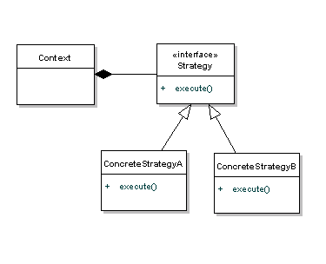
Visuals!

Slide 8
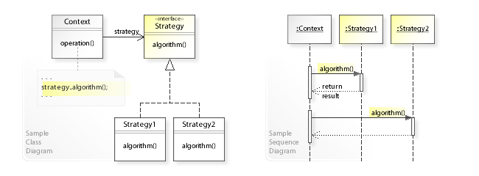
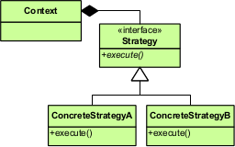
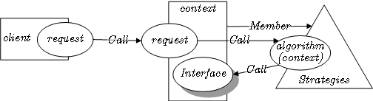
More Visuals!

Slide 9
When should I use it?
When you have a part of a “Class” that's subject to change frequently
When you have many related sub-classes which only differ in behavior, it's a good time to consider using a Strategy pattern.
When you want to hide complex logic or data that the client doesn't need to know about.

Slide 10
Strategy & Open/Closed Principle
According to the strategy pattern, the behaviors of a class should not be inherited. Instead they should be encapsulated using interfaces.
This is compatible with the open/closed principle (OCP), which proposes that classes should be open for extension but closed for modification.

Slide 11
TL;DR
We define a strategy pattern, we define a family of algorithms and encapsulate them (the behaviors) into classes so that they are interchangeable
The benefit of using strategy pattern is the independent algorithms and behaviors can vary independently of the clients that are consuming them

Slide 12
References
https://en.wikipedia.org/wiki/Strategy_pattern
http://robdodson.me/javascript-design-patterns-strategy/
http://www.blackwasp.co.uk/gofpatterns.aspx
https://sourcemaking.com/design_patterns/strategy
https://www.youtube.com/watch?v=QZIvlny1Onk
https://www.youtube.com/watch?v=Nx8iUv-ZnPw

Slide 13

Good Luck!

